Slide 1
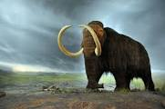

Lesson 3 ~ Extinct animals
Mrs. McNelis
Science

Slide 2
Objectives for lesson 3
Fossils help scientists learn about animals that lived long ago.
If an animal’s habitat changes, it may not find the food, water, and shelter it needs to live and may become extinct.
Many modern animals are similar to extinct animals.
Scientists can use fossils to determine if a modern animal is related to an extinct animal it resembles
An endangered species is a species that has so few individuals left it may soon become extinct.
Endangered species and their habitats must be protected or they may become extinct.

Slide 3
Developing vocabulary
endangered species
extinct species
fossil
habitat

Slide 4
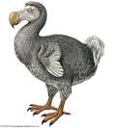
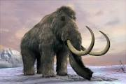
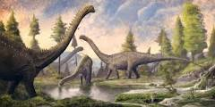
Listen to lesson 3

Slide 5
Review of lesson 3: Extinct animals
What is a fossil?
What do scientists learn from fossils?
Why might a species become extinct if its habitat is destroyed?
What is the difference between an endangered species and an extinct species?
Suggest a way you could help an endangered animal from becoming extinct?

Slide 6
Assignments for week of may 26
On a piece of paper, look up the 4 vocabulary words on Slide 3.
Watch a video about extinct and endangered animals.
On a piece of paper, complete the review questions on Slide 5.
EXTRA CREDIT: If you would like, you can make a model of a fossil. Example: Roll clay or Playdough into a ball. Press the ball flat with the palm of your hand. Press any object you’d like into the clay. Remove object from clay. The imprint in clay is similar to an imprint fossil!

Slide 7
